Slide 1
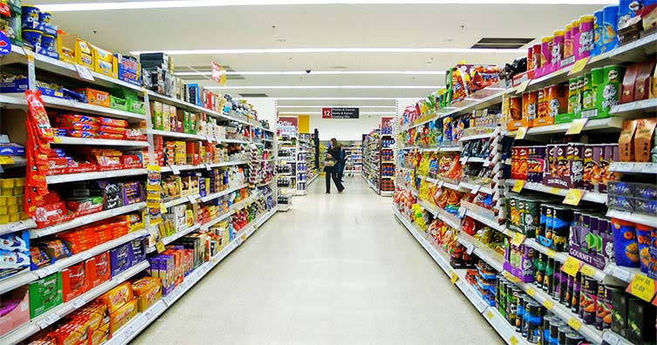
MARKET BASKET ANALYSIS BASED ON FREQUENT ITEM SET MINING
PROJECT BY
KARTHIK V NAIR TVE16IE037
AFEEF T V LTVE16IE065
BONJOE TOM TVE16IE026
SHAZIN ASHRAF TVE16IE056

Slide 2
CONTENTS
INTRODUCTION
OBJECTIVE
SCOPE
LITERATURE REVIEW
STEPS IN APRIORI ALGORITHM
DATA COLLECTION
SYSTEM DESIGN
SEQUENCE DIAGRAM
GUI APPLICATION
IMPLEMENTATION
RESULTS AND DISCUSSION
CONCLUSION AND FUTURE SCOPE
REFERENCES

Slide 3
INTRODUCTION
One of the challenges for companies that have invested heavily in customer data collection is how to extract important information from their vast customer databases and product feature databases, in order to gain competitive advantage.
Market basket analysis is one of the data mining methods focusing on discovering purchasing patterns by extracting associations or co-occurrences from a store’s transactional data.

Slide 4
OBJECTIVE
To identify the frequent item set from the transaction on the basis of factors such as support , confidence, lift.
To determine the placements of products in the supermarket.
Analyze customer buying patterns

Slide 5
SCOPE
The project was done using the transactional data of BUYNSAVE supermarket in Kazhakootam,Trivandrum.
The data collected was pre processed before analyzing the relationship between the products.
Products were categorized and association rule mining was done in python environment.
An desktop application was also developed for the supermarket for ease of use based on python GUI.

Slide 6
LIMITATIONS
The project was done on the basis of 1500 transactions in the supermarket ,more transactional data could result in better relations among the products.
Due to limited amount of data, many similar products of various brands were categorized.
If more transactional data was obtained the association among different product brands can be found out.
The purchasing pattern of the customers can vary due to a lot of factors which include seasonality, price and demography which can affect the obtained result.

Slide 7
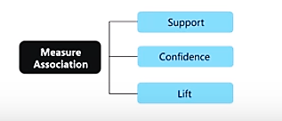
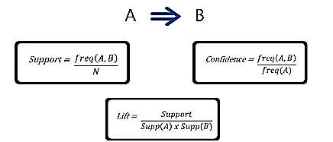
LITERATURE REVIEW
Association rule mining finds interesting association or relationships among a large data set.
Association rules are derived from the frequent item sets using support and confidence as threshold levels. The sets of items which have minimum support are known as Frequent Item set.[1]

Slide 8
STEPS IN APRIORI ALGORITHM
In the first iteration of the algorithm, each item is taken as a 1-itemsets candidate. The algorithm will count the occurrences of each item.
The set of 1 – item sets whose occurrence is satisfying the min support are determined. Only those candidates which count more than or equal to min support are taken ahead for the next iteration and the others are pruned

Slide 9
STEPS IN APRIORI ALGORITHM(CONT..)
Next, 2-itemset which are frequent items with min-support are discovered. For this in the join step, the 2-itemset is generated by forming a group of 2 by combining items with itself. The 2-itemset candidates are pruned using min-support threshold value.
The next iteration will form 3 –item sets using join and prune step.
Next step will follow making 4-itemset by joining 3-itemset with itself and pruning if its subset does not meet the min-support criteria. The algorithm is stopped when the most frequent item set is achieved.
Example of apriori.pptx

Slide 10
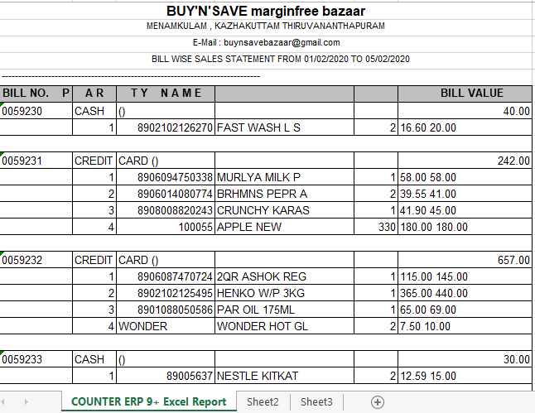
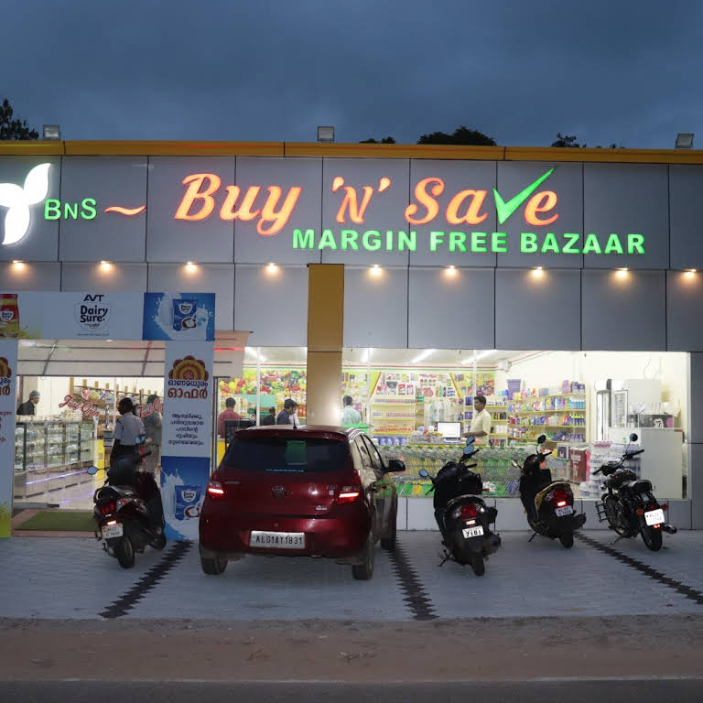
DATA COLLECTION
Buy N Save MARGIN FREE BAZAAR
Kazhakuttam Menamkulam Rd,
Thiruvananthapuram, Kerala 695582
The data was collected on 06/02/2020 for the days 01/02/2020 to 05/02/2020

Slide 11
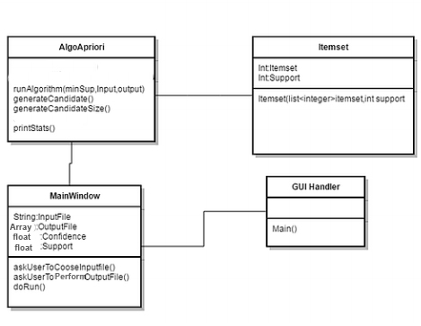
SYSTEM DESIGN

Slide 12
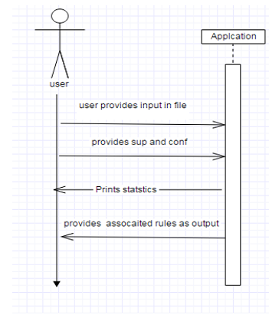
SEQUENCE DIAGRAM

Slide 13
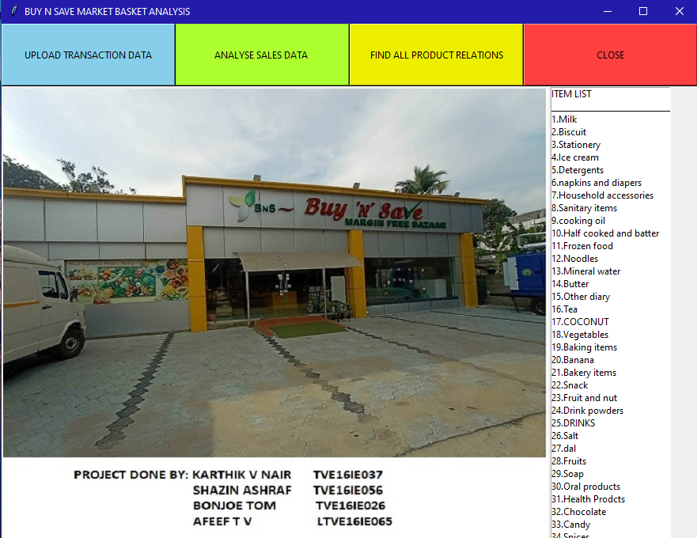
GUI APPLICATION
application.py

Slide 14
IMPLEMENTATION
Extracting the most frequent item sets
Our first step in the implementation of the algorithm is to extract the most frequent item sets by giving a threshold value of 0.01 for the support measure. This is done with the help of mlxtend library.
Extracting the rules which are dependent to each other
We can create our rules by defining metric and its threshold. In this step we will set our metric as “lift” to define whether antecedents and consequents are dependent or not. Threshold is selected as 1.1 since it is required to have lift scores above than 1 if there is dependency.

Slide 15
IMPLEMENTATION(CONT..)
Finding strong association rules
This is the most important step in which our aim is to find the strong association rules. We use confidence metric to extract the strong association rules from the whole transactions.
Finding other interesting relationships
In order to find the item sets which are strongly associated with carry bag, we extract the association rules in which carry bags appearing as consequent.

Slide 16
RESULTS AND DISCUSSION
MOST FREQUENT ITEMS
This gives us an idea about the buying behavior of the customers at super market. The store can plan the inventory management and marketing accordingly.

Slide 17
Strong relationships:
For finding the item sets with strong relationships we are focusing mainly on the confidence values.
The table below shows the rules with higher confidence values. The table is obtained after ensuring a support of at least 1 percent, the lift is greater than 1 and finally a confidence value greater than 40 percent

Slide 18
Strong relationships (cont..):
23 strong association rules were obtained. One strong association rule looks like this Cooking oil, condiments => curry powder (support: 6.7 percentage, confidence: 68.2 percentage)This rule means 6.7 percent of all the transaction contain these three items together and it is evident that cooking oil, condiments, and curry powder is having a very strong relationship.
Almost 70 percent of the people who purchased cooking oil and condiments also bought curry powder.

Slide 19
Some other interesting relationships(cont..):
From our analysis we noticed that carry bags appears in a good number of purchases.. So we try to extract the strong association rules in which carry bag appearing as a consequent.
The item set biscuit and onion is the one which makes strong relationship with the carry bag. 42 percent of the people who purchased biscuit and onion also bought carry bag.

Slide 20
CONCLUSION AND FUTURE SCOPE
The Apriori algorithm effectively generates highly informative frequent item sets and association rules for the data of the supermarket. The frequent data items are generated from the given input data and based on the frequent item stets strong association rules were generated.
Application can be efficiently used by using more efficient algorithm rather that Apriori Algorithm in future.
Integrating this software in the supermarket ERP system can yield realtime interpretations which could be used to tailor offers according to the market demand

Slide 21
REFERENCES
Fast Algorithms for Mining Association Rules in Large Databases R. Agrawal and R.Srikant,” Fast Algorithms for Mining Association Rules in Large Databases”, Journal ofComputer Science and Technology, vol. 15
Mining Interesting Rules by association and Classification Algorithms W. Yanthy, T. Sekiya,K. Yamaguchi„ FCST 09.
Market Basket Analysis RoshanSharma (https://www.kaggle.com/roshansharma/marketbasket-analysis)

